Slide 1
Predicting Fake Reviews at Amazon.com using Sentiment Analysis
Submitted by: Nikhil Aggarwal
Email id: nia45@pitt.edu

Slide 2
AGENDA
Objective
Amazon and importance of Online Review
Data Collection
Data Cleaning
Exploratory Analysis
Approach
Model : Naïve Bayes(Sentiment Analysis)
Model: Logistic Regression(helpfulness of votes)
Conclusion and Accuracy

Slide 3
Amazon and Importance of Online Reviews
Electronic ecommerce and cloud computing company.
Found on July 5,1994.
Largest Internet retailer in the world.
“A satisfied customer is the best business strategy of all”
90% of customers purchase based on online reviews.
Sellers exploit this advantage by posting fake reviews.

Slide 4
Data Cleaning
Reduce
Reduce Data Size: Reduced from 30,00,000 rows to 5,00,000 rows based on data.
Remove
Remove NA Values: NA values were present as review headings.
Convert
Convert all variables as factors or continuous variables: Converted all variables in their respected format e.g. Date(Character) – Date(Date format), Star Rating -> Categorical Variables

Slide 5
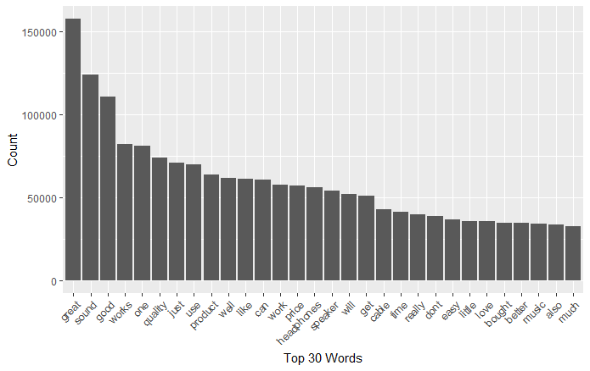
Exploratory Analysis

Slide 6


Data Analysis Approach
Text Mining
DTM and Frequent Five
Cross Validation Approach

Slide 7
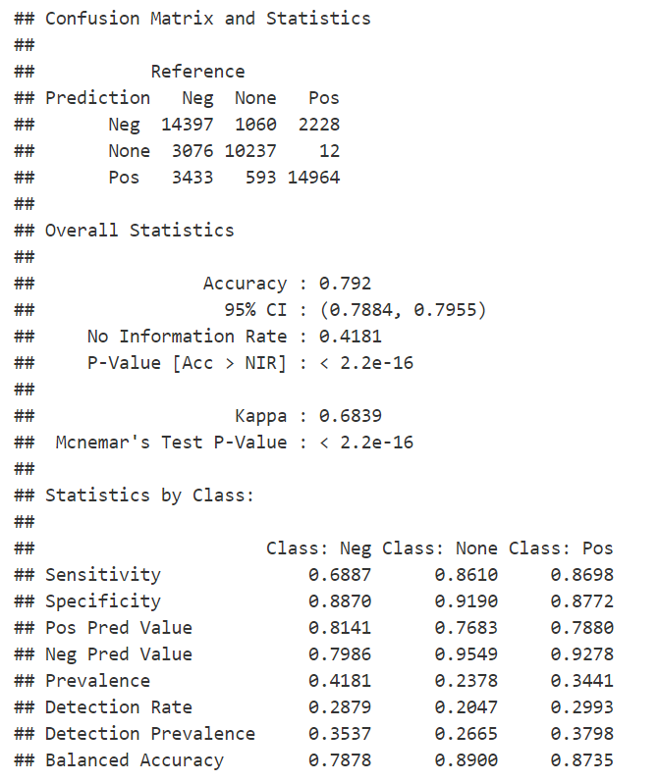
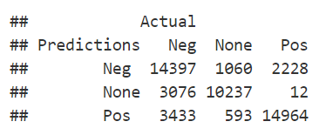
Naïve Bayes

Slide 8

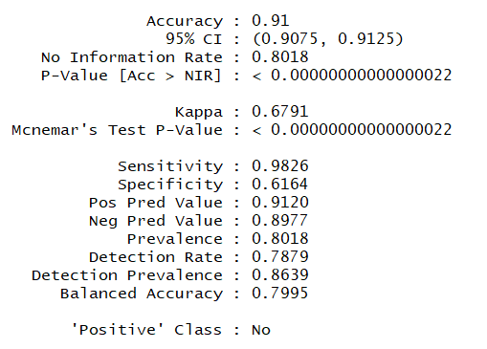
Logistic Regression

Slide 9
Conclusion
Predictive negative and positive sentiments is a branch of a bigger problem.
Naïve Bayes : 79.2%
Logistic Regression: 91%
Several other factors need to be analyzed to improve accuracy.

Slide 10

THANK YOU

